Slide 1
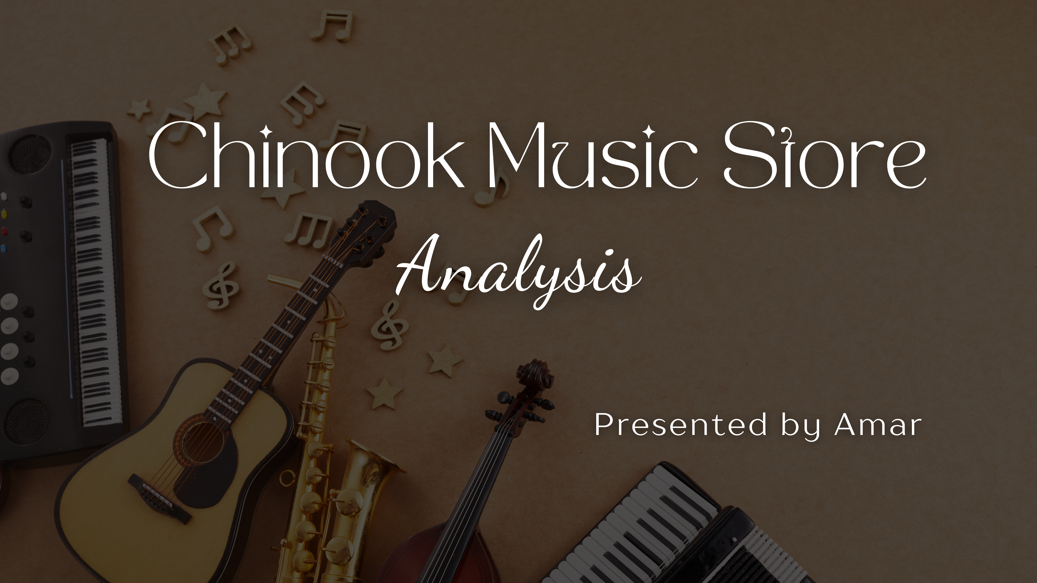

Slide 2
Agenda
About Chinook
Problem Statement
Data Description
Objective Key Metrics and Visualisation
Subjective Question for insights

Slide 3
About Chinook Store
Established in 1995, Chinook Music Service is a leading provider of musical instruments, accessories, rentals, and repair services in North Central Washington.
Chinook Music operates both a physical music store and music school, serving students, bands, and orchestras through in-person services.
The company also runs a digital music store, represented by the Chinook Music Store Database, which is widely used for SQL practice, data analysis, and business intelligence projects.

Slide 4
Business Goal
Since the music store holds large amounts of sales and customer data, so the main objective is to analyze music record sales data by
Identifying which genres, artists and album drive the most sales
Understanding the customer preferences and their purchasing behavior
Recognizing trends and underperforming areas
to gain insights and make informed strategic decisions / recommendations for growth in the physical music market

Slide 5
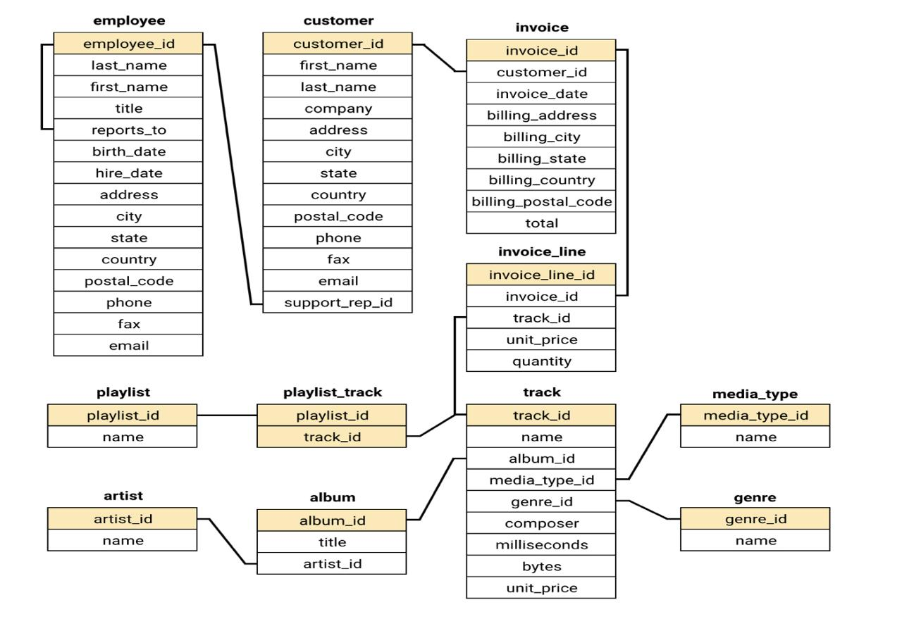
Data Schema

Slide 6
Data Understanding
This dataset provides a comprehensive view of Chinook’s market presence and operations.
The dataset consists of 11 relational tables containing information about the company’s operations.
Chinook has a global customer base across 24 countries.
The music catalog covers 25 genres such as Rock, Metal, Jazz, Classical, and more.
Each track is linked to its album and artist information, allowing deeper analysis of music trends.
The invoice table records all transactions, enabling sales and revenue analysis.

Slide 7
Data Description
Customer Table:
customer_id: Unique identifier assigned to each customer.
first_name: The given name or first name of a customer.
last_name: The surname or family name of a customer.
company: The name of the company associated with a customer.
address: The street address of a customer's location.
city: The city where a customer is located.
state: The state or province where a customer is located.
country: The country where a customer is located.
postal_code: The postal or zip code of a customer's address.
phone: The phone number of a customer.
fax: The fax number associated with a customer.
email: The email address of a customer.
support_rep_id: The employee ID of the support representative assigned to a customer.
Invoice Table:
invoice_id: Unique identifier assigned to each invoice.
customer_id: The customer ID associated with the invoice.
invoice_date: The date when the invoice was generated or issued.
billing_address: The street address used for billing purposes.
billing_city: The city used for billing purposes.
billing_state: The state or province used for billing purposes.
billing_country: The country used for billing purposes.
billing_postal_code: The postal or zip code used for billing purposes.
total: The total amount due on the invoice

Slide 8
invoice_line Table:
invoice_line_id: Unique identifier assigned to each line item on an invoice.
invoice_id: The invoice ID to which the line item belongs.
track_id: The ID of the track or product included in the line item.
unit_price: The price per unit for the line item.
quantity: The quantity of units for the line item.
Playlist Table:
playlist_id: Unique identifier assigned to each playlist.
name: The name or title of the playlist
Playlist_track Table:
playlist_id: The ID of the playlist to which the track belongs.
track_id: The ID of the track included in the playlist.
Track Table:
track_id: Unique identifier assigned to each track or song.
name: The title or name of the track.
album_id: The ID of the album to which the track belongs.
media_type_id: The ID of the media type associated with the track.
genre_id: The ID of the genre associated with the track.
composer: The name of the composer or artist who composed the track.
milliseconds: The duration of the track in milliseconds.
bytes: The file size of the track in bytes.
unit_price: The price per unit for the track.

Slide 9
Methodology
Data Extraction:- Extracted data from Chinook SQL database (customers, invoices, tracks, genres, albums, artists).
Data Cleaning :- Null values are identified using IS NULL operator and they are handled and duplicate values are checked on basis of primary key (No duplicates were found).
Descriptive Analysis :- MySQL queries have been performed for each task using AGGREGATE FUNCTIONS, GROUP BY, ORDER BY, JOINS, SUB QUERIES, CTEs, WINDOW FUNCTIONS and many functions. Text functions like CONCAT and date functions like DATEDIFF, and TIMESTAMP DIFF are utilized in various queries.
Examine the results :- Insights and recommendations are drawn from the output of these tasks.
Visualizations :- In specific cases, charts are created using Excel.

Slide 10
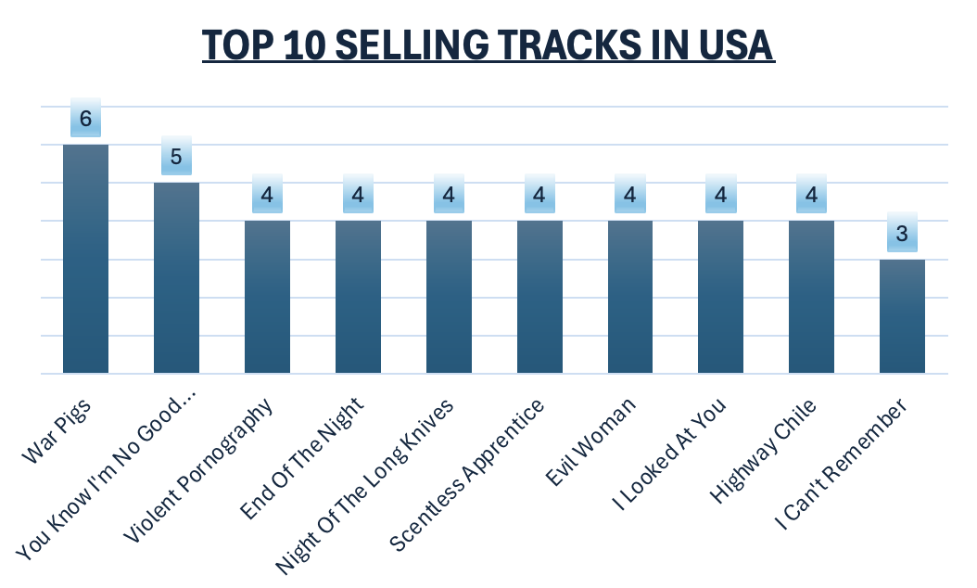
Key Metrics and Visualization
Top Selling Tracks in USA
The top selling track in USA is "War Pigs " with revenue of 5.94.
The second top selling track in USA is "You Know I’m No Good (feat. Ghostface Killah)" with revenue of 4.95.
Multiple tracks generated $3.96 revenue with 4 units sold (e.g. End Of The Night, Scentless Apprentice).

Slide 11
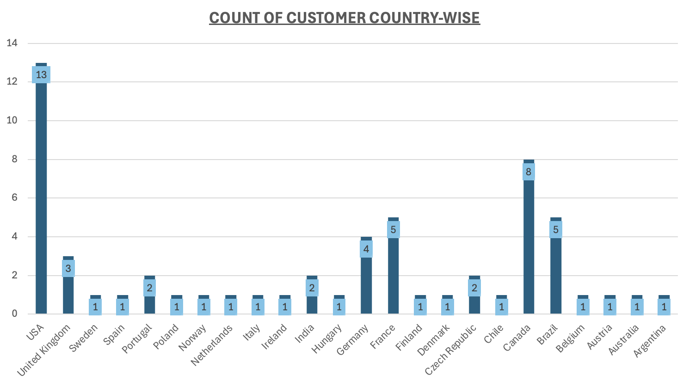
Total Customers Per Country
Customer Demographic Breakdown Based on Location
It shows that the customers are from 24 different countries.
The customer demographic breakdown is very diversified.
Maximum number of customers are from USA.

Slide 12
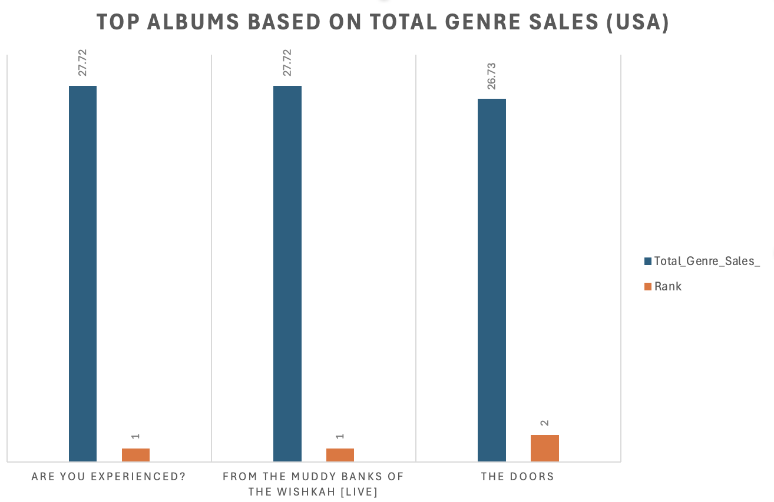
Top Albums Based on Total Genre Sales
According to Total Sales Top 3 Albums are:
From The Muddy Banks Of The Wishkah [Live]
Are You Experienced?
The Doors.
Rock is the dominant genre in the USA, with the top three albums all belonging to this category.
These albums generate the highest sales, making them strong promotion candidates.

Slide 13
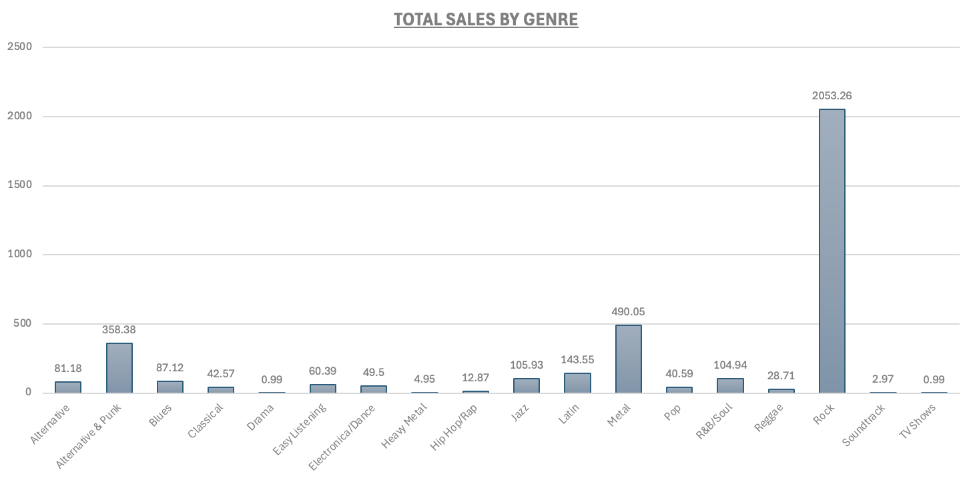
Total Sales by Genre
Rock, Metal, and Alternative & Punk are the top-selling genres globally.
Rock leads sales across both the USA and international markets.
Latin, Jazz, R&B/Soul, and Blues show strong global demand.

Slide 14
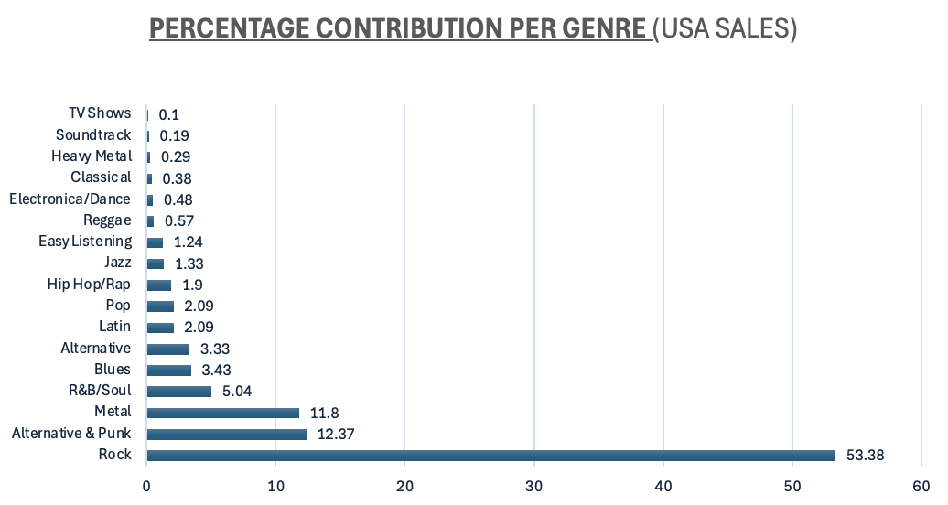
Percentage Contribution Per Genre
Calculate The Percentage Of Total Sales Contributed By each Genre In The USA
It shows that Alternative genre is contributing most to the Sales generated in the USA.
The 2nd and 3rd most selling genres are Rock, Punk and Blues.

Slide 15
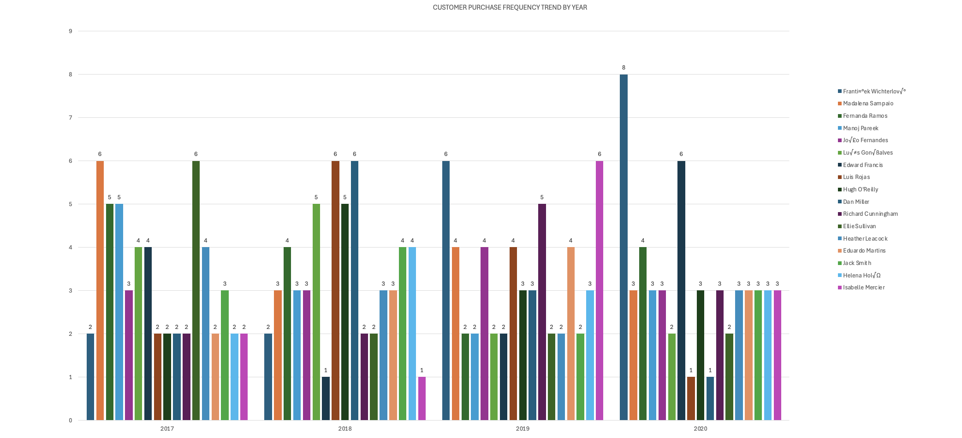
Customer Purchasing Behavior
Customer Purchase Frequency Yearly
František Wichterlová shows strong growth in purchases over time, indicating rising engagement.
Some customers exhibit irregular buying behavior, while others maintain stable purchase patterns.
2020 shows mixed trends, with both increases and declines in customer activity.
High-engagement spikes are visible for individual customers in specific years.

Slide 16
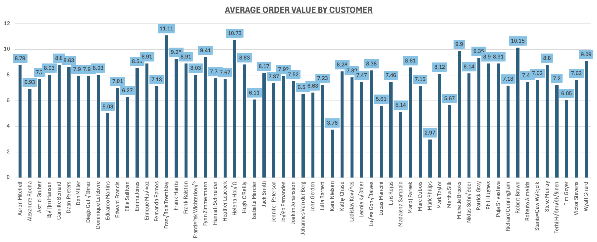
Customer Average Order Value
François Tremblay has the highest average order value, indicating premium spending behavior.
Most customers spend $7–$9 per order, representing the typical purchase pattern.
A few customers show lower average spend, reflecting smaller or selective purchases.
Above-average buyers maintain consistently higher per-order spending.

Slide 17
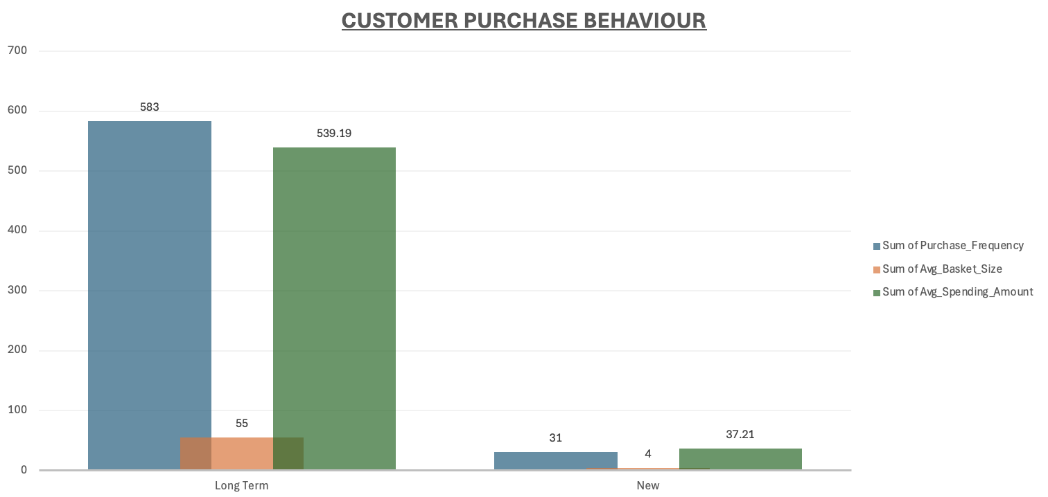
Customer Purchase Behaviour
Customer Purchasing Behavior Analysis
Long-term customers make far more purchases (583) and contribute the majority of total spending. Their average spending amount (539) is much higher compared to new customers.
New customers show very low purchase frequency and basket size, meaning most of them churn quickly.
The company’s growth depends on retaining long-term customers and converting new buyers into repeat customers.
Most revenue comes from long-term customers. New customers drop off fast, which increases churn. If we improve engagement and offer better deals for new buyers, we can convert them into loyal customers.

Slide 18
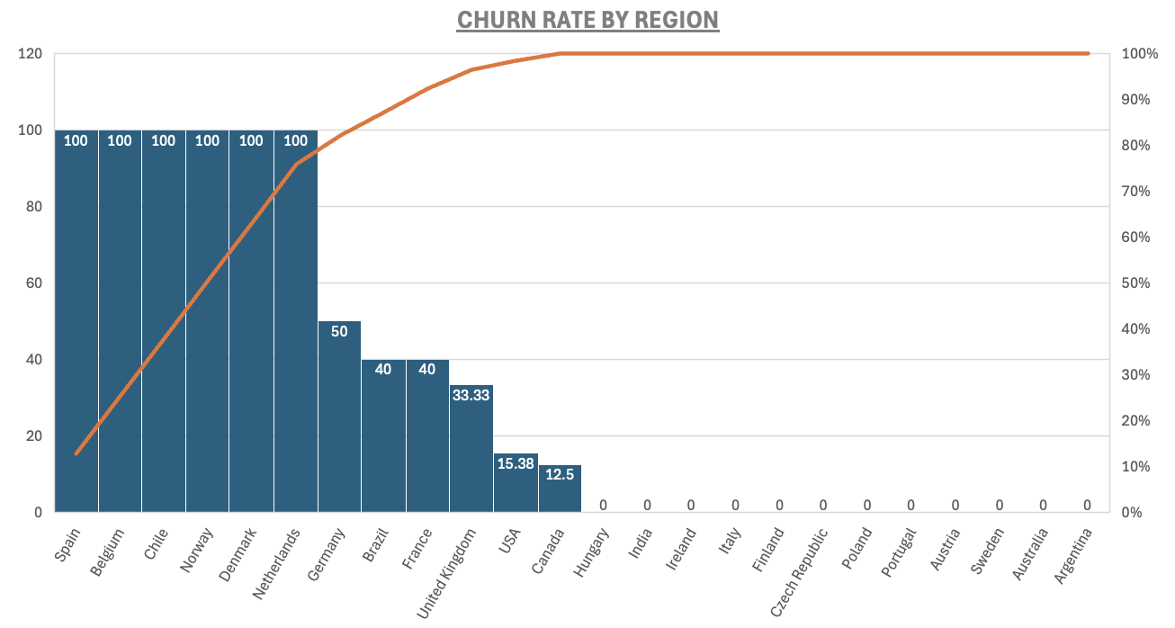
Churn Rate by Region
Regional Market Analysis
USA has the highest number of customers, orders, and revenue. Rock music’s popularity could be a big reason.
Canada comes second in customers, orders, and revenue. English language and developed economy may explain this.
Czech Republic has the highest average order value (9.11) and purchase frequency (15 orders per customer). This suggests people there spend more on music.
Countries like Spain, Norway, and Netherlands show a 100% churn rate, but each has only 1 customer, so this isn’t meaningful.
Among big markets:
USA churn rate = 15.38%
Canada churn rate = 12.50%
Germany shows a churn rate of 50% (2 of 4 customers stopped buying).
France and Brazil each have a churn rate of 40% (2 of 5 customers churned). This may be due to less interest in English-language music.

Slide 19
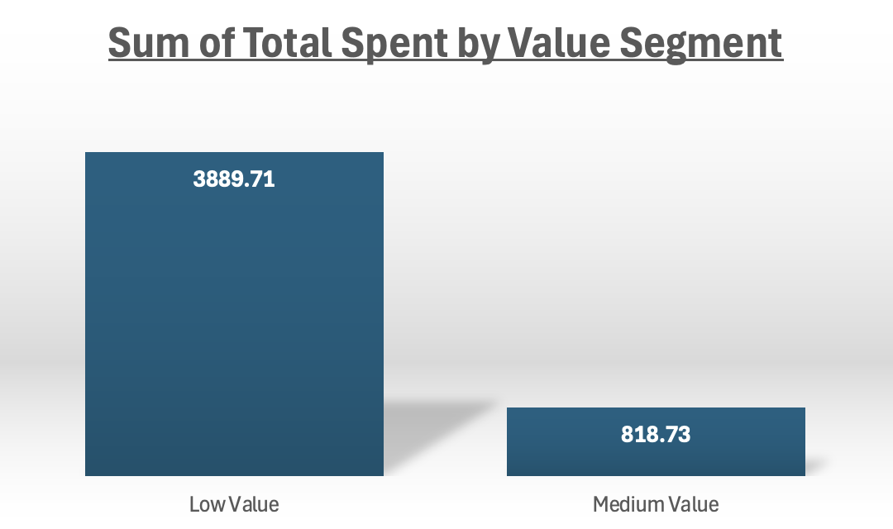
Customer Risk Profiling
Majority of customers are classified as High Risk due to long inactivity periods (most last purchases over 1700 days ago).
Even customers with frequent orders have Low Value, indicating low spending per order.
Countries like Canada, Denmark, Argentina, Italy, USA, and Belgium have several high-risk, low-value customers.

Slide 20
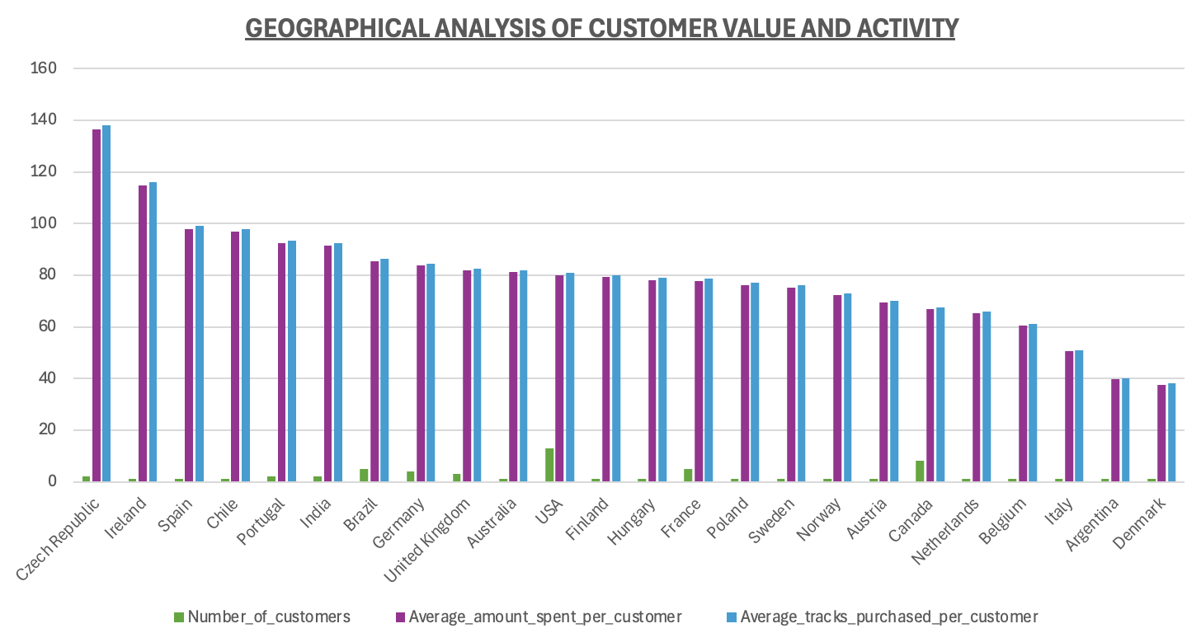
Geographical Analysis of Customer Value
Czech Republic has the highest average spend per customer, indicating strong individual customer value.
The USA has the largest customer base but lower average spend per customer.
India, Portugal, and Brazil show moderate customer spending levels.
Argentina and Denmark record the lowest average spending.
Some countries with single high-value customers show high average spend despite low customer count.

Slide 21
Recommendations
Prioritize the USA market with additional targeted promotional campaigns.
Expand into new countries to grow the global customer base.
Make customer retention a top priority to drive long-term revenue growth.
Reduce churn in high-risk regions through loyalty programs and targeted offers.
Focus on steady month-over-month sales growth.
Use personalized recommendations and email marketing to increase customer engagement and sales.

Slide 22
Conclusion
Chinook Music has strong opportunities to grow its sales by using customer and sales data wisely. Key focus areas include:
Boosting Customer Value: Learn from top-spending customers and countries to increase average order size and total revenue.
Smart Market Targeting: Focus marketing on regions with many customers (like the USA) and high-spending countries (such as Czech Republic, Ireland, and Chile) for maximum impact.
Smarter Music Catalog: Keep updating the catalog based on trending genres and customer preferences to improve satisfaction and loyalty.

Slide 23
THANK YOU

